Slide 1
Classes & Objects
Object Oriented Programming
Lecture # 6
Prepared by: Mehak Usmani

Slide 2
Content
Object Modeling
Class
Object
Relation between Class and Object
Writing program using classes and objects
Constructors
Types of Constructors

Slide 3
Simplification Through Abstraction
we’re innately skilled at abstraction, a process that involves recognizing and focusing on the important characteristics of a situation or object, and filtering out or ignoring all of the unessential details
Consider the example of a road map
Consider a landscape

Slide 4
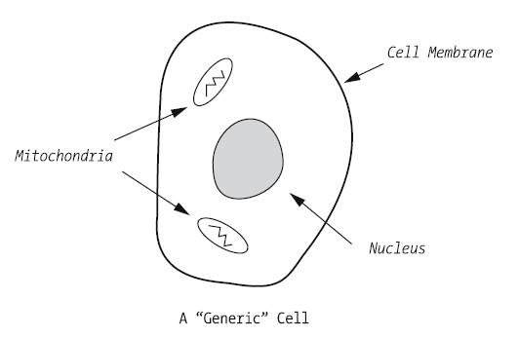
Generalization Through Abstraction
A generic abstraction of a cell

Slide 5
Organizing Abstractions into Classification Hierarchies
Human beings systematically arrange information into categories according to established criteria; this process is known as classification.
In order for a natural object to be classified as an animal, it must satisfy the following rules:
• It must be a living being.
• It must be capable of spontaneous movement.
• It must be capable of rapid motor response to stimulation.
The rules for what constitutes a plant, on the other hand, are different:
• It must be a living being (same as for an animal).
• It must lack an obvious nervous system.
• It must possess cellulose cell walls.

Slide 6
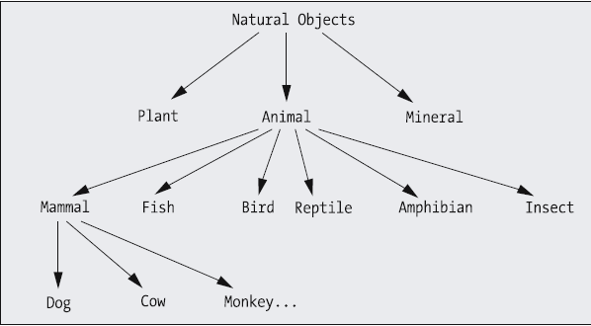
Abstraction hierarchy

Slide 7
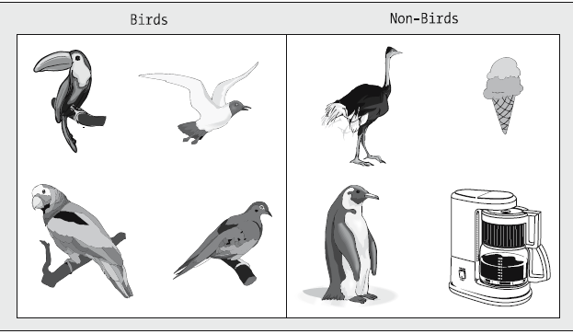
What makes a Bird?
• Has feathers
• Has wings
• Lays eggs
• Is capable of flying

Slide 8
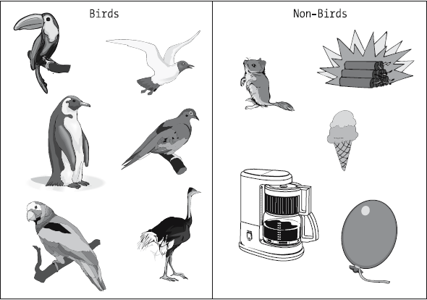
Make some adjustments
• Has feathers
• Has wings
• Lays eggs

Slide 9
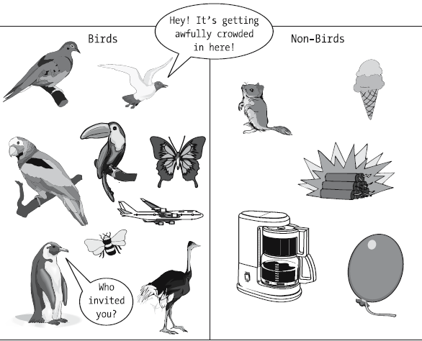
Some more refinements….?
• Has feathers
• Has wings
Or simply
• Has wings

Slide 10
Abstraction As the Basis for Software Development
Our decisions of inclusion versus elimination when building a software system must be made within the context of the overall purpose and domain, or subject matter focus, of the future system.
Example: Representing a person in a software system
Modeling is the process by which we develop a pattern for something to be made. An object model of a software system is such a pattern.
Modeling and abstraction go hand in hand, because a model is essentially a physical or graphical portrayal of an abstraction; before we can model something effectively, we must have determined the essential details of the subject to be modeled.

Slide 11
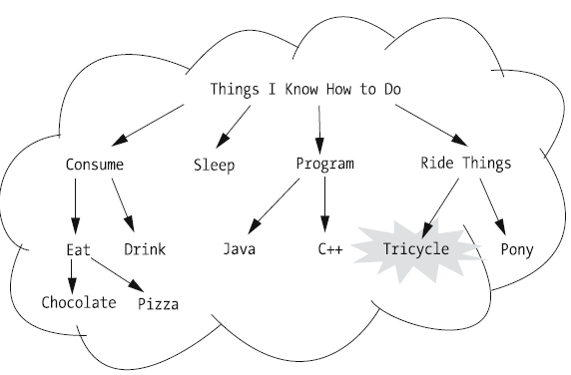
Reuse of Abstractions
Technique of comparing features to find an abstraction that is similar enough to be reused successfully is known as pattern matching and reuse.

Slide 12
Inherent Challenges
Many possibilities
Never a single “best” model
However, there is a thing as an “incorrect” model
No acid test to determine the validity of a model

Slide 13
What Does It Take to Be a Successful Object Modeler?
Insight into the problem domain
Creativity
Good listening skills
Good observational skills
organized process
way to communicate(UML)
software tool for automation

Slide 14
Classes
A class defines the properties and behaviors for objects.
In OOP terminology we say, class of an object contains collection of
Methods &
Data.
Classes are structures that defines objects.
A class is a template, blueprint, or contract that defines what an object’s data fields and methods will be.
A Java class uses variables to define properties and methods to define actions.
A class is a programmer-defined type and is a reference type.

Slide 15
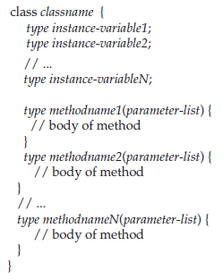
class Syntax

Slide 16
Objects
An object represents an entity in the real world that can be distinctly identified. An object has a unique identity, state, and behavior.
Examples: a student, a desk, a circle, a button, and a loan.
The state of an object (also known as its properties or attributes) is represented by data fields with their current values.
The behavior of an object (also known as its actions) is defined by methods.
An object is an instance of a class. Many instances can be created from a single class.
The terms object and instance are often interchangeable.

Slide 17
object Syntax
ClassName object_name;
object_name = new ClassName();
or simply
ClassName object_name = new ClassName();
or with parameters in constructor
ClassName object_name = new ClassName(type parameter);

Slide 18
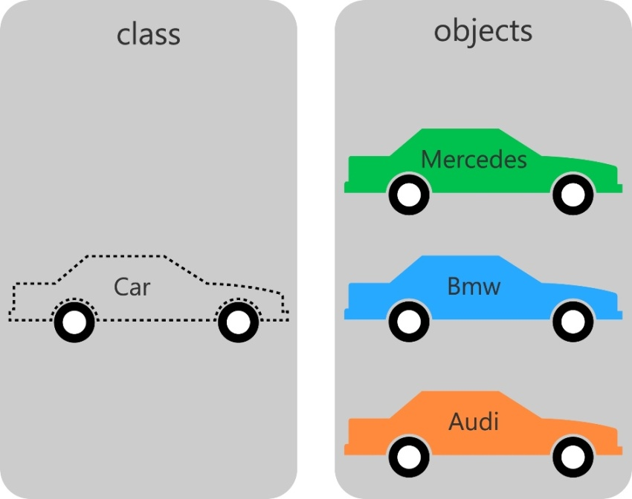
Relation between Class & Object
Classes are definitions for objects and objects are created from classes.
A class creates a new data type that can be used to create objects.
The relationship between classes and objects is analogous to that between a recipe and dish prepared by it.
Many objects can be created from the same class and they all will share the class's methods and properties. The objects will still be different because they may have different values assigned to their properties.

Slide 19

new operator
The new operator dynamically allocates memory for an object.
It has this general form:
new allocates memory for an object during run time.
The advantage of this approach is that a program can create as many or as few objects as it needs during the execution. However, since memory is finite, it is possible that new will not be able to allocate memory for an object because insufficient memory exists. If this happens, a run-time exception will occur.

Slide 20
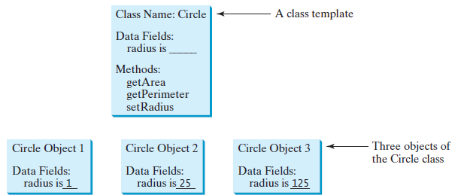
circle – an example
A circle object has a data field radius, which is the property that characterizes a circle. Similarly methods can be defined like getArea() and getPerimeter() for circle objects.

Slide 21
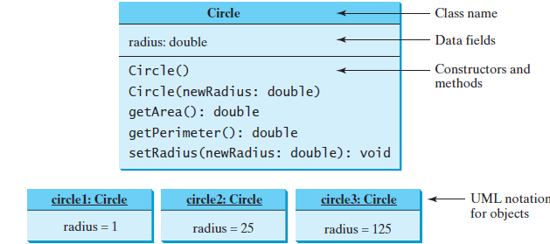
UML Class Diagram
Classes and objects can be represented using UML notation.

Slide 22
// Define the circle class with one variable and two methods
class Circle
{
double radius=10;
double getArea()
{
return radius * radius * Math.PI;
}
double getPerimeter()
{
return 2 * radius * Math.PI;
}
}

Slide 23
Declaring/Creating Objects in Single Step
ClassName objectRefVar = new ClassName();
Example:
Circle myCircle = new Circle();
Assign object reference
Create an object
Creat an object

Slide 24
Accessing Objects
Referencing the object’s data:
objectRefVar.data
e.g., myCircle.radius
Invoking the object’s method:
objectRefVar.methodName(arguments)
e.g., myCircle.getArea()

Slide 25
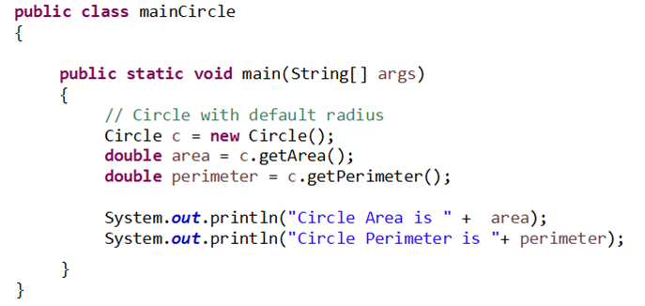
Calling Circle class via object:

Slide 26
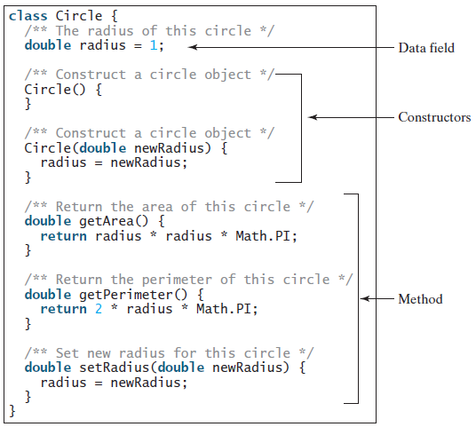
Implementing the circle class:

Slide 27
Implementing the circle class:
What’s missing?

Slide 28
Implementing the circle class:
It does not have a main method.

Slide 29
Constructor
A constructor is invoked to create an object using the new operator.
Constructors are a special kind of method.
They have three properties:
A constructor must have the same name as the class itself.
Constructors do not have a return type—not even void.
Constructors are invoked when an object is created. Constructors play the role of initializing objects.
A constructor initializes an object immediately upon creation. Once defined, the constructor is automatically called immediately after the object is created.
The implicit return type of a constructor is the class type itself therefore it does not allow to return any other thing
To construct an object from a class, invoke a constructor of the class using the new operator, as follows:
new ClassName(arguments);

Slide 30

Constructor
Is it a valid constructor for class Circle?

Slide 31

Constructor
It is a method, not a constructor.
Constructor does not have a return type.
It is a common mistake to put the void keyword in front of a constructor.

Slide 32
Constructor Types
There are following types of constructors:
Non-Parameterized constructor A class may provides a constructor without arguments. Such a constructor is referred to as a non-parameterized or no-argument constructor. Syntax: <class_name>(){}
Parameterized constructor A constructor that have parameters is known as parameterized constructor. It is used to provide different values to the distinct objects. Syntax: <class_name>(type parameter_name ){}
Default constructor A class may be defined without constructors. In this case, a public no-arg constructor with an empty body is implicitly defined in the class called default constructor.

Slide 33
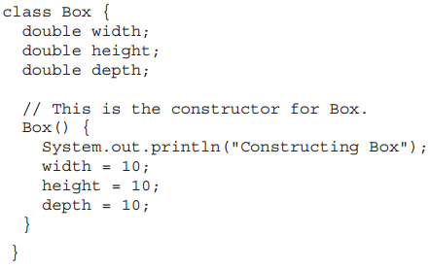
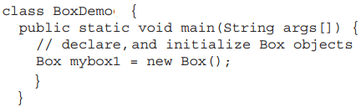
Non-Parameterized Constructor
Defining a Non-Parameterized Constructor
Calling a Non-Parameterized Constructor

Slide 34
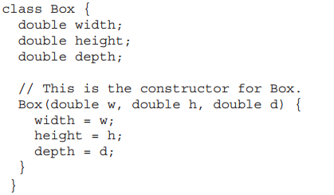
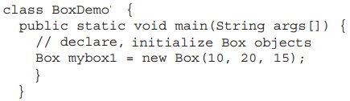
Parameterized Constructor
Defining a Parameterized Constructor
Calling a Parameterized Constructor

Slide 35
Constructor Overloading
Constructor overloading is a technique in Java in which a class can have any number of constructors that differ in parameter lists.
The compiler differentiates these constructors by taking into account the number of parameters in the list and their type.
A class may be defined without constructors.
The default constructor, is provided automatically only if no constructors are explicitly defined in the class.
Constructor returns current class instance yet it does not have a return type.

Slide 36
Constructor vs. Method
Constructor | Method
Constructor is used to initialize the state of an object. | Method is used to expose behaviour of an object.
Constructor must not have return type. | Method must have return type.
Constructor is invoked implicitly. | Method is invoked explicitly.
The java compiler provides a default constructor if you don't have any constructor. | Method is not provided by compiler in any case.
Constructor name must be same as the class name. | Method name may or may not be same as class name.

